Slide 1
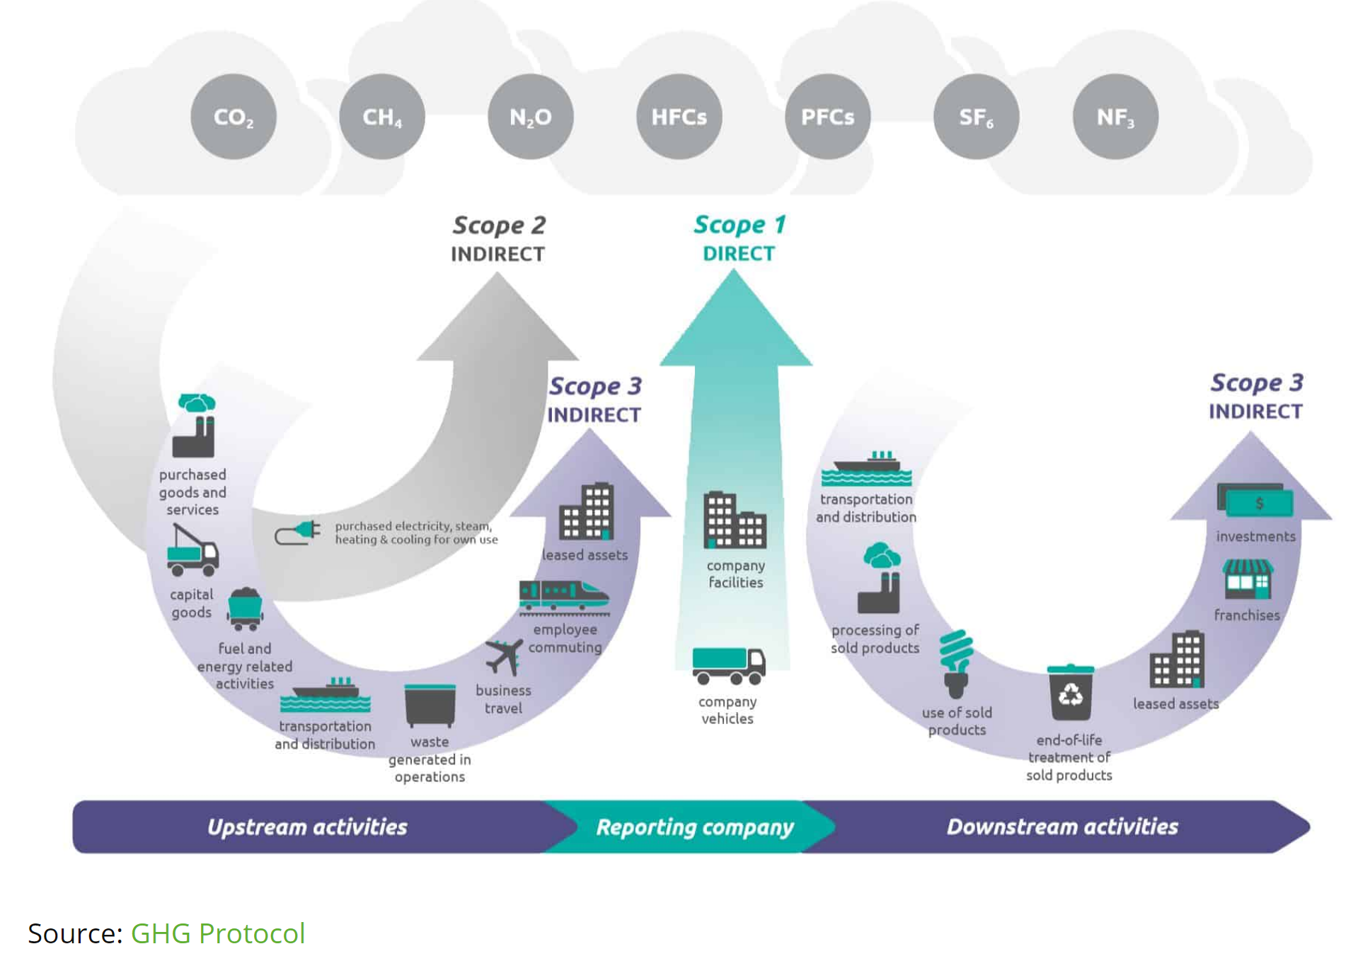
Green House Gas Protocol
Scope 1 – All Direct Emissions from the activities of an organization or under their control. This includes fuel combustion on site such as gas boilers, fleet vehicles and air conditioning leaks.
Scope 2 – Indirect Emissions from electricity purchased and used by the organization. Emissions are created during the production of the energy that is eventually used by the organization.
Scope 3 – All Other Indirect Emissions from activities of the organization occurring from sources that they do not own or control. These are usually the greatest share of the carbon footprint covering emissions associated with business travel, procurement, waste and water.
By accepting this document, the receiving party agrees to treat it as CONFIDENTIAL COMMERCIAL INFORMATION

